Slide 1



Acute Flaccid Paralysis Surveillance in Ireland
Updated 18/April/2018

Slide 2
HSE-HPSC | AFP Surveillance in Ireland
AFP surveillance and Polio
Surveillance of AFP is used in surveillance for poliomyelitis in the context of the global polio elimination initiative
Polio is caused by a human enterovirus called poliovirus. Wild polioviruses (WPV) occur naturally, of which there are three types
There is no cure for polio, it can only be prevented; Polio (poliomyelitis) mainly affects children under 5 years of age
1 in 200 infections leads to irreversible paralysis. Among those paralysed, 5% to 10% die when their breathing muscles become immobilized
Source: http://www.who.int/en/news-room/fact-sheets/detail/poliomyelitis

Slide 3
HSE-HPSC | AFP Surveillance in Ireland
Rationale for AFP surveillance worldwide (i)
Polio - one of only a limited number of diseases that can be eradicated as there are no long-term carriers of the disease and an inexpensive vaccine is available
Failure to eradicate polio from remaining strongholds could result in as many as 200 000 new cases every year, within 10 years, globally
In 1988, the Forty-first World Health Assembly adopted a resolution for the worldwide eradication of polio. It marked the launch of the Global Polio Eradication Initiative (GPEI), spearheaded by national governments, WHO, Rotary International, the US Centers for Disease Control and Prevention (CDC), UNICEF
Source: http://www.who.int/en/news-room/fact-sheets/detail/poliomyelitis

Slide 4
HSE-HPSC | AFP Surveillance in Ireland
Rationale for AFP surveillance worldwide (ii)
Cases die to wild poliovirus have decreased by over 99% since 1988, from an estimated 350 000 cases then, to 22 reported cases in 2017. As a result of the global effort to eradicate the disease, more than 16 million people have been saved from paralysis.
Of the 3 strains of wild poliovirus (type 1, type 2, and type 3), wild poliovirus type 2 was eradicated in 1999 and no case of wild poliovirus type 3 has been found since the last reported case in Nigeria in November 2012.
The incidence of WPV1 cases in 2017 is the lowest ever recorded.
Sources: http://www.who.int/en/news-room/fact-sheets/detail/poliomyelitis; http://www.who.int/news-room/detail/13-02-2018-statement-of-the-sixteenth-ihr-emergency-committee-regarding-the-international-spread-of-poliovirus

Slide 5
HSE-HPSC | AFP Surveillance in Ireland
Rationale for AFP surveillance worldwide (iii)
Increasing number of countries where immunization systems have been weakened/disrupted by conflict and complex emergencies underlines the potential of serious consequences for further international spread.
For example, after >2 years without detection of wild polio in Nigeria, the 3 laboratory confirmed WPV1 cases in children between 2 and 5 years of age with onset between July and August 2016 were confirmed
These detected viruses were closely linked to WPV1 last detected in the Nigerian state of Borno in 2011, an indication that this strain had been circulating without detection since that time
Sources: http://www.who.int/news-room/detail/13-02-2018-statement-of-the-sixteenth-ihr-emergency-committee-regarding-the-international-spread-of-poliovirus; http://www.who.int/csr/don/06-october-2016-polio-nigeria/en/

Slide 6
HSE-HPSC | AFP Surveillance in Ireland
Rationale for AFP surveillance worldwide (iii)
In addition to the wild polio cases reported in Nigeria in 2016, a vaccine-derived poliovirus type 2 (cVDPV2) has also been detected in specimens collected from a healthy household contact of one of the WPV1 cases recently reported as part of strengthened disease surveillance activities being implemented in the area.
The genetic analysis of the isolated strain indicates that also this cVDPV2 strain has been circulating in the area for at least two years.
Source: http://www.who.int/csr/don/06-october-2016-polio-nigeria/en/

Slide 7
HSE-HPSC | AFP Surveillance in Ireland
Rationale for AFP surveillance worldwide (iii)
Populations in fragile states are vulnerable to outbreaks and are exceedingly difficult to control and threaten the completion of global polio eradication during its end stage.
In February 2018
  states infected with WPV1, cVDPV1 or cVDPV3 include Afghanistan, Pakistan and Nigeria
  states infected with cVDPV2s include Democratic Republic of the Congo, Nigeria and Syrian Arab Republic
  States no longer infected by WPV1 or cVDPV, but which remain vulnerable to re-infection include Cameroon, Central African Republic, Chad and Niger
Source: http://www.who.int/news-room/detail/13-02-2018-statement-of-the-sixteenth-ihr-emergency-committee-regarding-the-international-spread-of-poliovirus

Slide 8
HSE-HPSC | AFP Surveillance in Ireland
Rationale for AFP surveillance worldwide (iv)
In 2015 coverage with 3 doses of polio vaccine was 94% in the European Region and 86% globally.
In June 2002, all 53 countries in the WHO European Region were certified polio free:
  Since certification, more than 90 million infants across the Region have received the recommended 3 doses of polio vaccine.
  National and regional surveillance systems and laboratories have ensured that no polio case could have been left undetected.
  A sustained effort of immunization and disease surveillance helps maintain the Region's polio-free status.
Source: http://www.euro.who.int/__data/assets/pdf_file/0005/276485/Factsheet-Polio-en.pdf?ua=1; http://www.euro.who.int/en/health-topics/communicable-diseases/poliomyelitis/maintaining-polio-free-status-of-european-region-as-part-of-the-global-polio-endgame-strategy

Slide 9
HSE-HPSC | AFP Surveillance in Ireland
Polio Eradication and Endgame Strategic Plan 2013–2018
On 26 May 2012, the World Health Assembly called for the development of a comprehensive strategy to achieve a polio-free world by 2018.
The plan lays out four objectives for the eradication of all polio disease, whether caused by wild poliovirus or circulating vaccine-derived poliovirus, and for the use of established structures to deliver other health services in the wake of eradication.
  to detect and interrupt all poliovirus transmission;
  to strengthen immunization systems and withdraw oral polio vaccines;
  to contain poliovirus and certify interruption of transmission;
  to plan polio's legacy.
Source: http://www.euro.who.int/en/health-topics/communicable-diseases/poliomyelitis/maintaining-polio-free-status-of-european-region-as-part-of-the-global-polio-endgame-strategy

Slide 10
HSE-HPSC | AFP Surveillance in Ireland
Rationale for AFP surveillance in Ireland
AFP in children < 15 years of age is a rare event in Ireland
AFP surveillance is used to ensure that if polio virus was the cause for the AFP that we would recognise it quickly so that action could be taken to prevent spread
In Ireland most AFP cases are caused by other enteric viruses (other entero- or other viruses)
Having an AFP surveillance in place ensures that investigation into this rare condition we can be sure that we do not miss a polio case if it were to occur

Slide 11
HSE-HPSC | AFP Surveillance in Ireland
Cases of Polio in Ireland, 1948-2017

Slide 12
HSE-HPSC | AFP Surveillance in Ireland
Irish surveillance for AFP- methods
Acute flaccid paralysis (AFP) in ALL children < 15 years of age
Investigation of suspect cases of CNS infection (e.g. meningitis, encephalitis, AFP) of all ages if travel or epi-links to contacts from areas where polio virus circulating

Slide 13
HSE-HPSC | AFP Surveillance in Ireland
Definition of AFP
Acute flaccid Paralysis (AFP) is a clinical syndrome characterised by rapid onset of weakness, including (less frequently) weakness of respiratory and swallowing, progressing to maximum severity within several days to weeks.
AFP is a complex clinical syndrome with a broad array of potential aetiologies.

Slide 14
HSE-HPSC | AFP Surveillance in Ireland
Potential aetiologies associated with AFP
Includes possible illness due to:
  Guillian-Barré syndrome
  Transverse myelitis
  Traumatic neuritis
  Viral infections caused by other enteroviruses, toxins and tumours

Slide 15
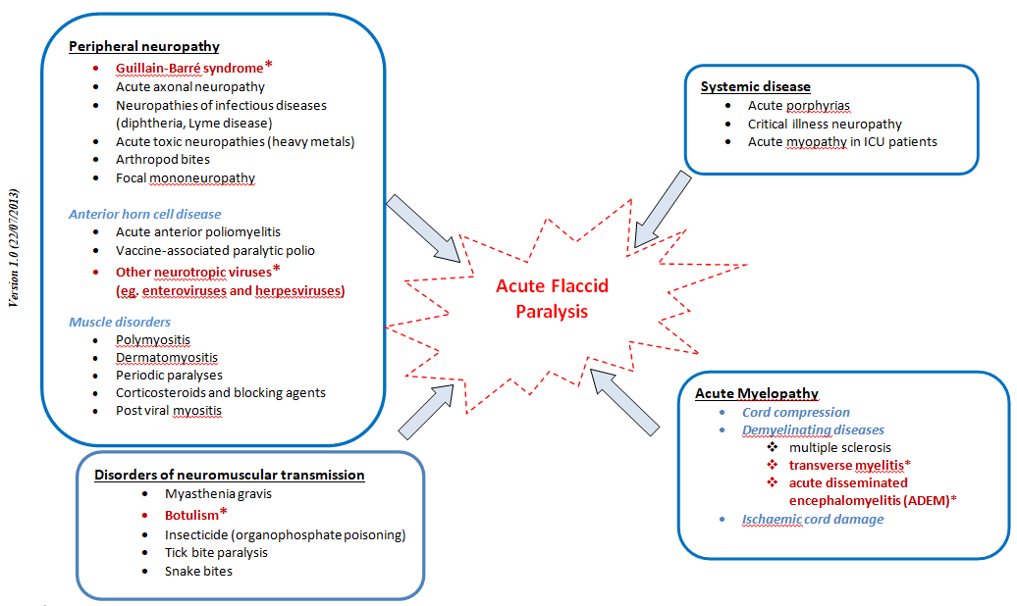
HSE-HPSC | AFP Surveillance in Ireland
Causes of Acute Flaccid Paralysis (AFP¹) Worldwide
Note: most common causes of AFP in Ireland indicated in red (*)
Notes:
¹Acute flaccid Paralysis (AFP); a clinical syndrome characterised by rapid onset of weakness, including (less frequently) weakness of respiratory and swallowing, progressing to maximum severity within several days to weeks. The term “flaccid” indicates the absence of spasticity or other signs of disordered central nervous system motor tracts such as hyperreflexia, clonus, or extensor plantar responses. AFP is a complex clinical syndrome with a broad array of potential aetiologies. Surveillance of AFP is of great public health importance because it is used in surveillance for poliomyelitis in the context of the global polio eradication initiative

Slide 16
HSE-HPSC | AFP Surveillance in Ireland
Objectives of AFP surveillance
To rapidly detect re-importation of poliovirus into polio-free areas
To ensure that robust surveillance systems are in place so that if AFP caused by polio virus that it would be identified quickly

Slide 17
HSE-HPSC | AFP Surveillance in Ireland
AFP Investigation in aged children < 15 years
AFP case admitted to hospital
Collect 2 stool specimens as early as possible, 24 hours apart, within 2 weeks of paralysis onset and send to National Virus Reference Laboratory (NVRL)
Complete AFP enhanced surveillance form and return to Paula Flanagan, HPSC, 25‐27 Middle Gardiner Street, Dublin 1, Tel: 01 876 5300, Fax: 01 856 1299
Surveillance forms available on ward or available at http://www.hpsc.ie/hpsc/A-Z/VaccinePreventable/Polio/AcuteFlaccidParalysisAFP/
When returning your monthly IPSU (Irish Paediatric Surveillance Unit) card indicate if you have seen a case in previous month

Slide 18
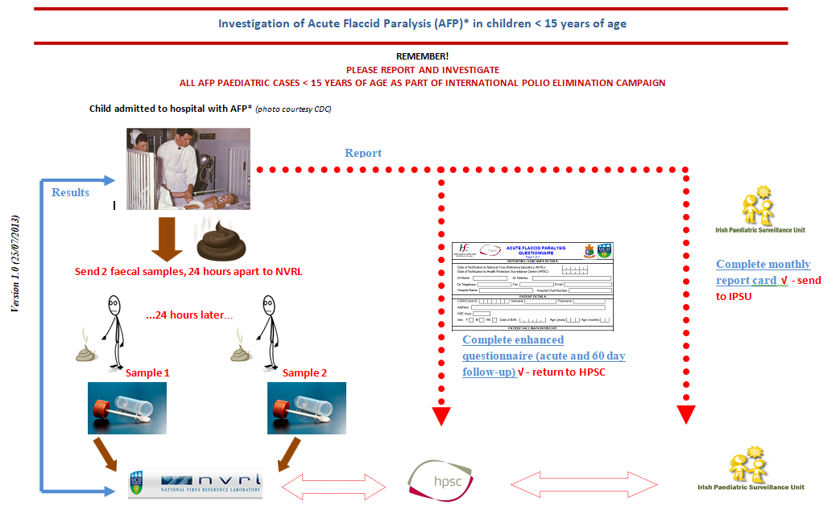
HSE-HPSC | AFP Surveillance in Ireland
AFP Reporting Poster
* photo courtesy CDC
Notes:
* Acute flaccid Paralysis (AFP); a clinical syndrome characterised by rapid onset of weakness, including (less frequently) weakness of respiratory and swallowing, progressing to maximum severity within several days to weeks. The term “flaccid” indicates the absence of spasticity or other signs of disordered central nervous system motor tracts such as hyperreflexia, clonus, or extensor plantar responses.
AFP is a complex clinical syndrome with a broad array of potential aetiologies. Surveillance of AFP is of great public health importance because it is used in surveillance for poliomyelitis in the context of the global polio eradication initiative

Slide 19
HSE-HPSC | AFP Surveillance in Ireland
AFP reports in children < 15 years of age,
by year onset paralysis, 2009-2017
Year of Onset of Paralysis | Total
2009 | 6
2010 | 4
2011 | 9
2012 | 6
2013 | 8
2014 | 10
2015 | 5*
2016 | 7
2017 | 3*
2009-2017 | 58
* excludes one where IPSU reported a suspect AFP case but no enhanced surveillance details were available

Slide 20
HSE-HPSC | AFP Surveillance in Ireland
AFP cases by Age Group, 2009-2017
Age Group | Total
0-4 | 28
5-9 | 8
10-14 | 12
Not specified | 10
Total | 58*
* excludes two (in 2015 and 2017) where IPSU reported a suspect AFP case but no enhanced surveillance details were available

Slide 21

HSE-HPSC | AFP Surveillance in Ireland
Acknowledgements
The HPSC wishes to thank all those who have contributed to polio surveillance:
  National Virus Reference Laboratory (NVRL)
  Irish Paediatric Surveillance Unit (IPSU)
  Paediatricians in Irish hospitals
  Siobhan O’Malley, Nurse, Temple Street Children’s Hospital

