Slide 1


EARS-Net data
on
Antimicrobial Resistance
in
Ireland, 2022

Slide 2
Key Points
In 2022, 35 of 36 microbiology laboratories in Ireland submitted data on invasive infections (predominantly bloodstream infections) for 8 key pathogens, including E. coli and S. aureus
One laboratory did not submit data due to resource issues
The estimated population coverage by EARS-Net Ireland in 2022 was >97%
Data were received on 7,129 isolates in 2022 compared with 6,578 in 2021
The number of invasive infections increased by 6% between 2021 and 2022 (data adjusted to include only those laboratories that consistently reported data over the latest 5-year period)
For most pathogens, there was an increase in the number of cases reported in 2022 compared to 2021, with the biggest increases seen for Group A streptococcus (up 126%; coinciding with the upsurge in iGAS infections at the end of 2022), S. pneumoniae (up 69%; but still below pre-pandemic levels), P. aeruginosa (up 11%) and Acinetobacter spp. (up 11%)

Slide 3
Key Points: change in numbers of cases reported by pathogen
(data adjusted to include only those laboratories that consistently reported over the latest 5-year period)

Slide 4
Key Points
E. coli: Resistance to most of the key antibiotics has decreased over the last 5 years
S. aureus: The proportion of meticillin-resistant S. aureus (%MRSA) remains stable at 10.6%, which is still the lowest level to date. MRSA has been decreasing across Europe
K. pneumoniae: Resistance to many of the key antibiotics, most notably to fluoroquinolones (now at 9.6%, down from 16.3% in 2021), has decreased over the last 5 years. Ireland has some of the lowest resistance levels in Europe
E. faecium: The proportion of vancomycin-resistant E. faecium (%VREfm) has decreased over the past 5 years from 40.2% in 2018 to 27.5 % in 2021; however, this is due to an increase in susceptible E. faecium (VSEfm; up by over 80% in the last 5 years) while the numbers of VREfm have remained relatively stable. VREfm is a growing problem throughout Europe
Acinetobacter spp.: Although resistance levels in Acinetobacter spp. remain low in Ireland, the numbers of isolates has increased over the past 5 years. Resistance in Acinetobacter spp., especially to carbapenems, is one of the greatest AMR threats to global health according to the WHO

Slide 5
Key Points: significant trends in resistance

Slide 6
Why do surveillance?
Infectious disease surveillance is important in monitoring and evaluating emerging patterns and trends of disease. It provides information for action, thus timely data collection, validation, analysis, feedback and reporting is very important
Through surveillance we can:
  Describe the current burden and epidemiology of a disease
  Monitor trends over time
  Investigate emergence and spread of new pathogens and variants
  Inform policy makers for action
  Observe the effects of interventions
EARS-Net Data on Antimicrobial Resistance in Ireland, 2022

Slide 7
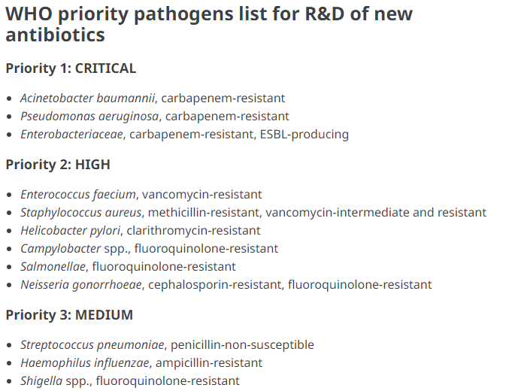
Why do surveillance of antimicrobial resistance?
Antimicrobial resistance has been recognised as a major threat to human health globally
In 2017, WHO prepared a list of ‘priority pathogens’ that have developed resistance to key antibiotics used to treat the infections they cause and for which new antibiotics are urgently required

Slide 8
EARS-Net Background
Established as European Antimicrobial Resistance Surveillance System (or EARSS) in 1998 by EC DG-SANCO
  Dutch Public Health Institute (RIVM) was responsible for Europe-wide co-ordination
  HPSC in Ireland was responsible for data collection and analyses for Ireland
Surveillance system later transferred to ECDC in 2010
  Name changed to EARS-Net
  An international network of national surveillance systems with laboratories and hospitals from 29 EU/EEA countries (now excluding the UK) participating in 2022
  Aims to collect comparable & reliable antimicrobial resistance (AMR) data for public health action
EARS-Net Data on Antimicrobial Resistance in Ireland, 2022

Slide 9

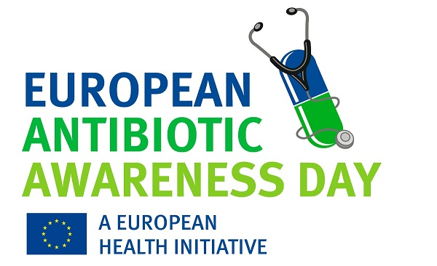
EARS-Net Objectives
Collect comparable, representative and accurate AMR data
Analyse temporal and spatial trends of AMR in Europe
Provide timely AMR data for policy decisions
Encourage the implementation, maintenance and improvement of AMR surveillance programmes
Support national systems in their efforts to improve diagnostic accuracy by offering an annual External Quality Assessment (EQA)
EARS-Net Data on Antimicrobial Resistance in Ireland, 2022

Slide 10
EARS-Net Case Definition
EARS-Net collects antimicrobial resistance data on:
  Escherichia coli
  Staphylococcus aureus
  Enterococcus faecium
  Klebsiella pneumoniae
  Streptococcus pneumoniae
  Enterococcus faecalis
  Pseudomonas aeruginosa
  Acinetobacter spp.
the first invasive isolate (from blood or cerebrospinal fluid) for
each of the EARS-Net pathogens listed below,
per patient,
per year
EARS-Net Data on Antimicrobial Resistance in Ireland, 2022

Slide 11
EARS-Net Data
Routinely-generated data from laboratories on key antibiotics for eight pathogens under surveillance
  Qualitative (RIS) data
  Quantitative data: MIC results, including from gradient diffusion (e.g., Etests) in mg/l. This is especially important for pneumococci/penicillin and cefotaxime
EUCAST vs CLSI guidelines situation as of 2022
  32 labs have now adopted EUCAST guidelines (>97% of all isolates)
    ***Note: ECDC only accepts data from EUCAST labs since 2019***
  3 labs still use CLSI
Reference laboratory data
  Serotypes on pneumococci
  Confirmation of K. pneumoniae and E. coli isolates that are carbapenemase-producing CRE
EARS-Net Data on Antimicrobial Resistance in Ireland, 2022

Slide 12
EARS-Net Data
Nationally, data stored in WHONET format (a free software from WHO, which is versatile for collecting, storing and analysing AMR data) and in an Access Database at HPSC
Locally, data can be sent as:
  WHONET files
  Laboratory Information Management System (LIMS) files, that can be translated to WHONET via software called BacLink
  Excel data collection tool provided by HPSC
It is recommended that all electronic files should be encrypted before being sent to HPSC by email
EARS-Net Data on Antimicrobial Resistance in Ireland, 2022

Slide 13

EARS-Net Participation
Over the past 5 years, the estimated coverage of the Irish population has consistently been over 95%
In 2022, there was an estimated 97.5% coverage of the population: one laboratory did not participate due to resource issues
Coverage varies considerably in other EU/EEA countries from <20% to 100%
Countries are also required to participate in the annual EARS-Net EQA exercise:
  In 2020, this exercise was cancelled throughout Europe due to the pandemic
  In 2021, Ireland didn’t participate due to resource issues
  In 2022, participation in Ireland recommenced; however, 6 of 37 labs did not participate
EARS-Net Data on Antimicrobial Resistance in Ireland, 2022

Slide 14
Important changes to case definitions
No changes since 2022 (relating to 2021 and 2022 data)
2021 (relating to 2020 data)
  P. aeruginosa and aminoglycosides: only data on tobramycin is now collected by EARS-Net. This has had a big impact on the MDR definition
  Data on all pathogens now collected from blood or CSF samples. Previously CSF samples not collected for S. aureus or the enterococci
2020 (relating to 2019 data)
  Only data from laboratories following EUCAST guidelines can be submitted to EARS-Net at ECDC
  Although HPSC continues to collect data from the 3 labs still following CLSI guidelines thus the data reported for Ireland by ECDC can differ from data reported nationally
EARS-Net Data on Antimicrobial Resistance in Ireland, 2022

Slide 15

Invasive Escherichia coli
infections

Slide 16
Invasive Escherichia coli Infections
Key Points
The number of invasive E. coli infections increased by 6% between 2021 and 2022 (data adjusted to include only those laboratories that consistently reported data over the latest 5-year period)
Resistance to most of the key antibiotics has decreased over the last 5 years
Multi-drug resistance (MDR) accounted for 3.7% of isolates in 2022, a decrease from 4.2% in 2021; Overall, the 5-year trend also indicates that the %MDR E. coli is decreasing
The 5-year trend indicates that the %carbapenem-resistant E. coli is increasing (but the numbers are low); Four E. coli isolates were found to be carbapenemase-producers (or CPE) in 2022
EARS-Net Data on Antimicrobial Resistance in Ireland, 2022

Slide 17
Invasive Escherichia coli Infections
3GC: 3rd-Generation Cephalosporins (include cefotaxime, ceftazidime)
ESBL: Extended-Spectrum Beta-Lactamase
MDR: Multi-Drug Resistance (defined as combined resistance to 3GCs, fluoroquinolones and aminoglycosides)
*Not all isolates tested
‡ Data is missing from one laboratory for each of 2021 and 2022
EARS-Net Data on Antimicrobial Resistance in Ireland, 2022

Slide 18
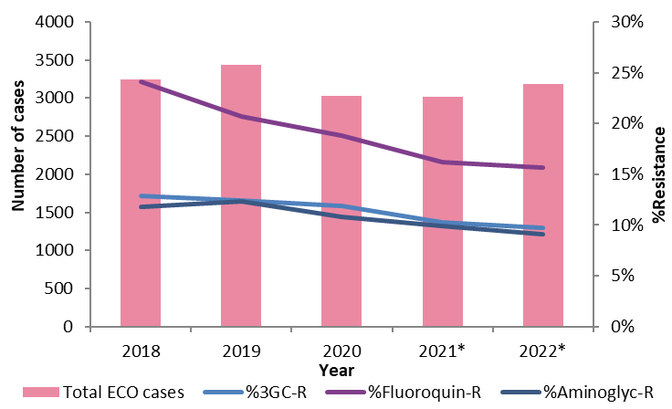
Trends in 3GC-, fluoroquinolone- and aminoglycoside-resistant Escherichia coli
3GC, 3rd-Generation Cephalosporins (include cefotaxime, ceftazidime)
*Data is missing from one laboratory for each of 2021 and 2022
Significant 5-year trend
EARS-Net Data on Antimicrobial Resistance in Ireland, 2022

Slide 19
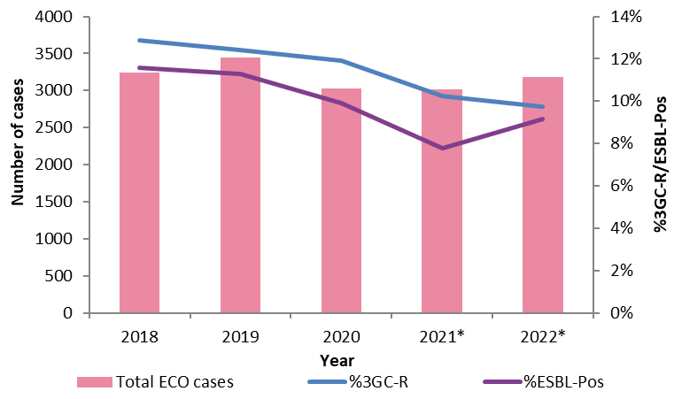
Trends in 3GC-resistant and ESBL-producing
Escherichia coli
3GC, 3rd-Generation Cephalosporins (include cefotaxime, ceftazidime)
ESBL, Extended-Spectrum Beta-Lactamase
* Data is missing from one laboratory for each of 2021 and 2022
Significant 5-year trend
EARS-Net Data on Antimicrobial Resistance in Ireland, 2022

Slide 20
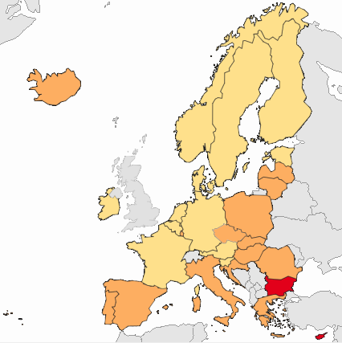
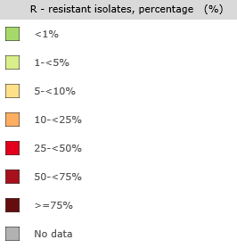
3GC-resistant Escherichia coli in EARS-Net countries in 2021
Data for 2022 not yet available
IE rank: 18/29 (10.0%)
EU/EEA: 13.8%
(population-weighted mean)
Significant 5-year trend
3GC, 3rd-Generation Cephalosporins (include cefotaxime, ceftazidime)
Source: Health Atlas, ECDC (data downloaded 26/09/2022)
EARS-Net Data on Antimicrobial Resistance in Ireland, 2022

Slide 21
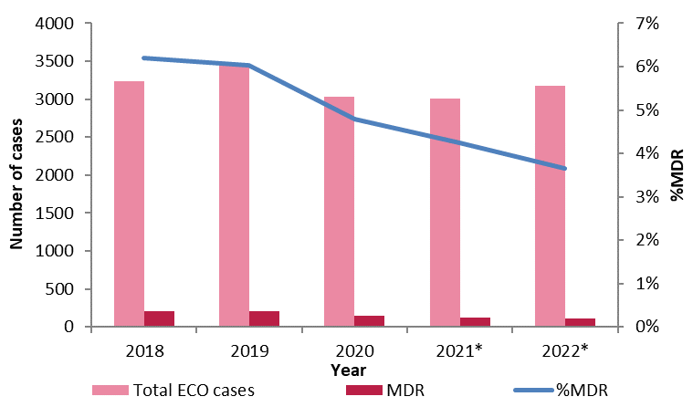
Trends in multi-drug resistant
Escherichia coli
Multi-drug resistance accounted for 3.7% (or just under 1 in 25) of isolates in 2022, a decrease from 4.1% in 2021
MDR, Multi-Drug Resistance (defined as combined resistance to 3GCs, fluoroquinolones and aminoglycosides)
* Data is missing from one laboratory for each of 2021 and 2022
Significant 5-year trend
EARS-Net Data on Antimicrobial Resistance in Ireland, 2022

Slide 22
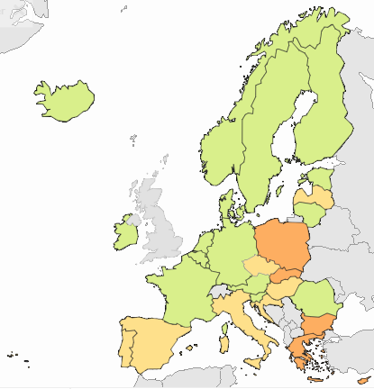
Multi-drug resistant Escherichia coli
in EARS-Net countries in 2021
Data for 2022 not yet available
IE rank: 17/29 (4.0%)
EU/EEA: 5.1%
(population-weighted mean)
MDR E. coli is decreasing in Ireland
Significant 5-year trend
MDR, Multi-drug resistant
Source: Health Atlas, ECDC (data downloaded 26/09/2022)
EARS-Net Data on Antimicrobial Resistance in Ireland, 2022

Slide 23
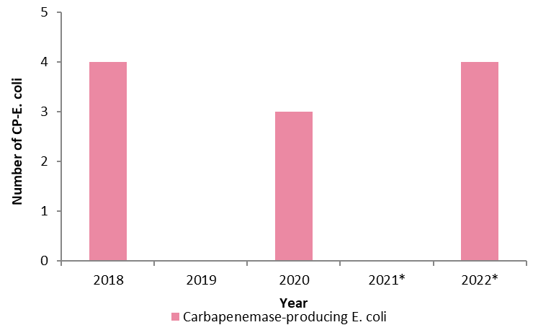
Carbapenem Resistance and Carbapenemase Producing E. coli
Although the 5-year trend for carbapenem-resistant E. coli shows an increase, the numbers are still low.
No trend is obvious for carbapenemase-producing E. coli
*Data is missing from one laboratory for each of 2021 and 2022
EARS-Net Data on Antimicrobial Resistance in Ireland, 2022

Slide 24

Invasive Staphylococcus aureus
infections

Slide 25
Invasive Staphylococcus aureus Infections
Key Points
The number of invasive S. aureus infections remained stable between 2021 and 2022 (data adjusted to include only those laboratories that consistently reported data over the latest 5-year period)
In 2022, the proportion of methicillin-resistant S. aureus (%MRSA) remained stable at 10.6%. The %MRSA is the lowest recorded level to date. The 5-year trend indicates that %MRSA is decreasing
This is mirrored by a small decrease in the MRSA rate to 0.031 per 1,000 Patient Days, also at its lowest level to date
There was also a decrease in the rate of methicillin-susceptible S. aureus (MSSA) to 0.263 per 1,000 Patient Days. This is compared to 0.277 in 2021, which was the highest recorded rate to date
EARS-Net Data on Antimicrobial Resistance in Ireland, 2022

Slide 26
Invasive Staphylococcus aureus Infections
Between 2021 and 2022, MRSA has remained stable in Ireland.
At 10.6%, this is the lowest %MRSA reported to date
EARS-Net Data on Antimicrobial Resistance in Ireland, 2022

Slide 27
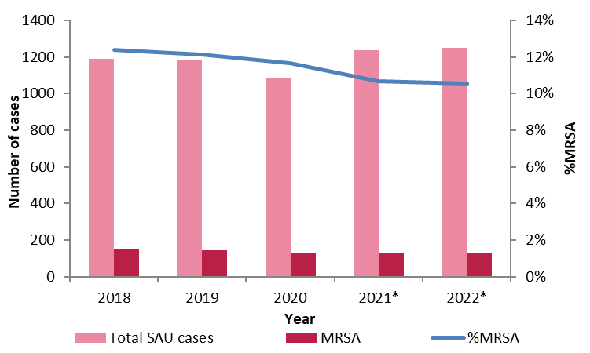
Trends in Meticillin-Resistant Staphylococcus aureus (MRSA)
In 2022, %MRSA decreased to 10.6% (or just over 1 in 10 cases), the lowest level to date
MRSA, Methicillin Resistant Staphylococcus aureus
* Data is missing from one laboratory for each of 2021 and 2022
Significant 5-year trend
EARS-Net Data on Antimicrobial Resistance in Ireland, 2022

Slide 28

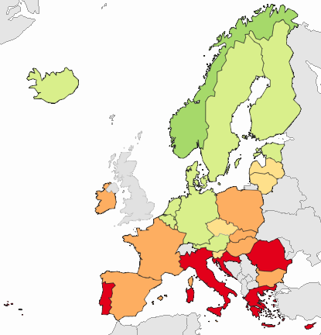
MRSA in EARS-Net countries in 2021
Data for 2022 not yet available
IRL rank: 14/29 (10.6%)
EU/EEA: 15.8%
(population-weighted mean)
MRSA is decreasing across the EU/EEA, but many countries in Southern Europe still have high levels
Significant 5-year trend
MRSA, Methicillin Resistant Staphylococcus aureus
Source: Health Atlas, ECDC (data downloaded 26/09/2022)
EARS-Net Data on Antimicrobial Resistance in Ireland, 2022

Slide 29
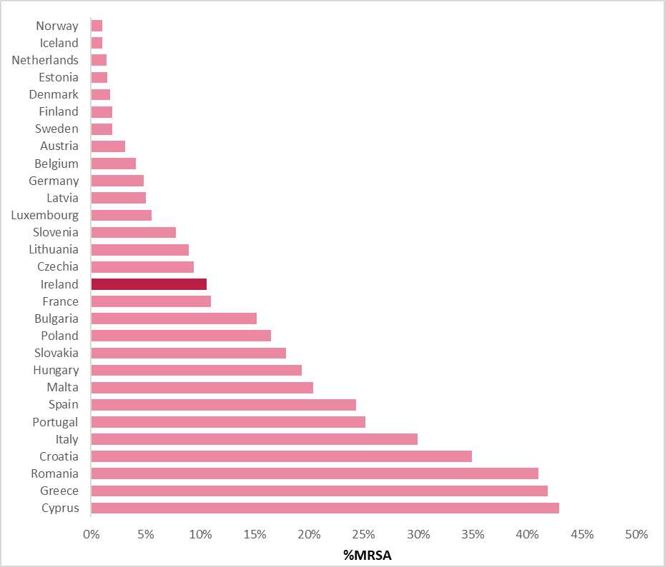
MRSA in EARS-Net countries in 2021
Data for 2022 not yet available
Countries arranged from lowest (top) to highest (bottom) in terms of %MRSA
MRSA, Methicillin Resistant Staphylococcus aureus
Source: Health Atlas, ECDC (data downloaded 26/09/2022)
EARS-Net Data on Antimicrobial Resistance in Ireland, 2022

Slide 30
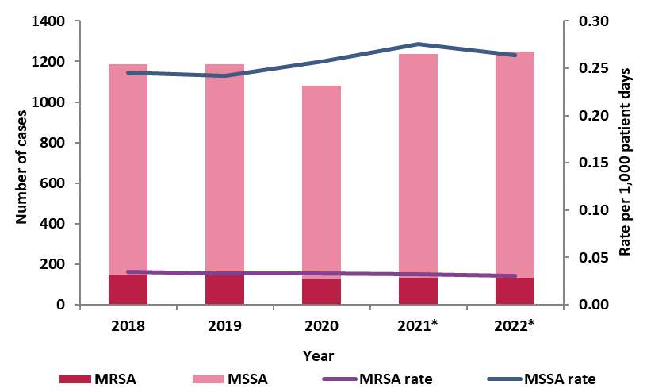
%MRSA versus
MRSA rate per 1,000 Patient Days
While the %MRSA and MRSA rate showed a decreasing trend over the last 5 years, the MSSA rate increased between 2018 and 2021 with a decrease observed in 2022.
As the rate only depends on the number that are either resistant (for MRSA) or susceptible (for MSSA), the rate per 1000 Patient Days (also called Bed Days Used) is often considered to be the best indicator for looking at the trend.
For further details on invasive S. aureus/MRSA infections in Ireland, including data by individual acute hospitals, see
https://www.hpsc.ie/a-z/microbiologyantimicrobialresistance/europeanantimicrobialresistancesurveillancesystemearss/referenceandeducationalresourcematerial/saureusmrsa/latestsaureusmrsadata/
MRSA, Methicillin Resistant Staphylococcus aureus
MSSA, Methicillin Sensitive Staphylococcus aureus
* Data is missing from one laboratory for each of 2021 and 2022
EARS-Net Data on Antimicrobial Resistance in Ireland, 2022

Slide 31

Invasive Klebsiella pneumoniae
infections

Slide 32
Invasive Klebsiella pneumoniae Infections
Key Points
The number of invasive K. pneumoniae infections decreased by 3% between 2021 and 2022 (data adjusted to include only those laboratories that consistently reported data over the latest 5-year period)
Resistance to most of key antibiotics decreased between 2021 and 2022, with the biggest drop seen for fluoroquinolones (2021, 16.3%; 2022, 9.6%); These decreases are mirrored by a decreasing 5-year trend
Multi-drug resistance (MDR) accounted for 3.3% of isolates in 2022, a decrease from 8% in 2021; Overall, the 5-year trend indicates that the %MDR E. coli is also decreasing
Five K. pneumoniae isolates were found to be carbapenemase-producers (or CPE) in 2022
Still relatively low levels of resistance overall in Ireland compared to other EU/EEA countries
EARS-Net Data on Antimicrobial Resistance in Ireland, 2022

Slide 33
Invasive Klebsiella pneumoniae Infections
3GC, 3rd-Generation Cephalosporins (include cefotaxime, ceftazidime)
ESBL, Extended-Spectrum Beta-Lactamase
MDR, Multi-Drug Resistance (defined as combined resistance to 3GCs, fluoroquinolones and aminoglycosides)
*Not all isolates tested
‡ Data is missing from one laboratory for each of 2021 and 2022
EARS-Net Data on Antimicrobial Resistance in Ireland, 2022

Slide 34
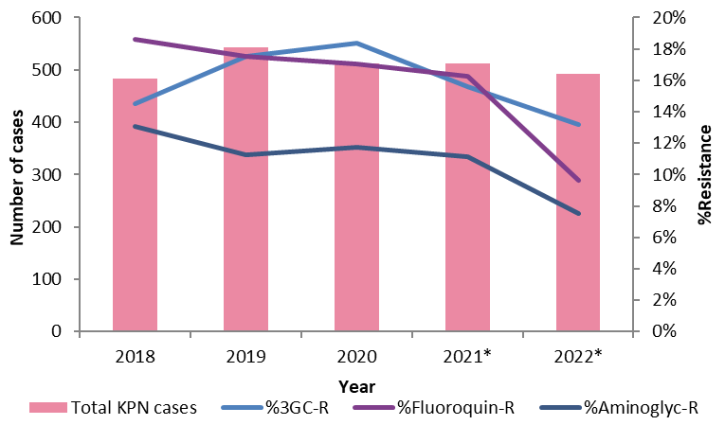
Trends in 3GC-, fluoroquinolone- and aminoglycoside-resistant Klebsiella pneumoniae
3GC, 3rd-Generation Cephalosporins (include cefotaxime, ceftazidime)
*Data is missing from one laboratory for each of 2021 and 2022
Significant 5-year trend
EARS-Net Data on Antimicrobial Resistance in Ireland, 2022

Slide 35
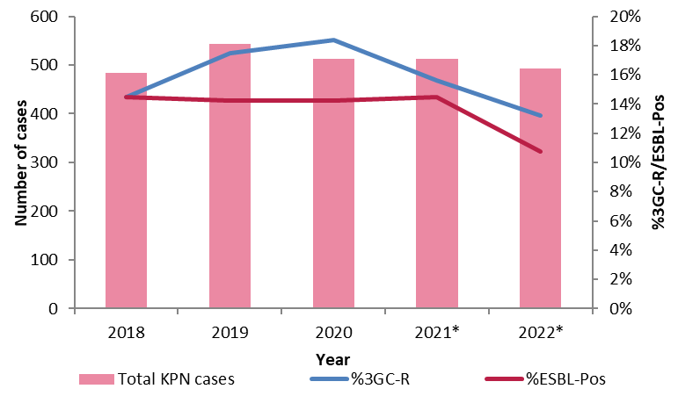
Trends in 3GC-resistant and ESBL-producing
Klebsiella pneumoniae
3GC, 3rd-Generation Cephalosporins (include cefotaxime, ceftazidime)
ESBL, Extended-Spectrum Beta-Lactamase
* Data is missing from one laboratory for each of 2021 and 2022
Significant 5-year trend
EARS-Net Data on Antimicrobial Resistance in Ireland, 2022

Slide 36
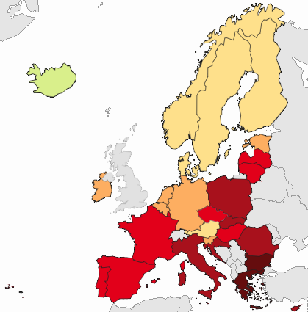
3GC-resistant Klebsiella pneumoniae in EARS-Net countries in 2021
Data for 2022 not yet available
IRL rank: 20/29 (15.5%)
EU/EEA: 34.3%
(population-weighted mean)
The proportion of resistance to 3GCs in K. pneumoniae in Ireland is one of the lowest among EU/EEA countries
The % of 3GC-resistance among K. pneumoniae is:
75-100% = 2 countries
50-<75% = 6 countries
25-<50% = 9 countries
(mostly in Eastern and Southern Europe)
Significant 5-year trend
3GC, 3rd-Generation Cephalosporins (include cefotaxime, ceftazidime)
Source: Health Atlas, ECDC (data downloaded 26/09/2022)
EARS-Net Data on Antimicrobial Resistance in Ireland, 2022

Slide 37
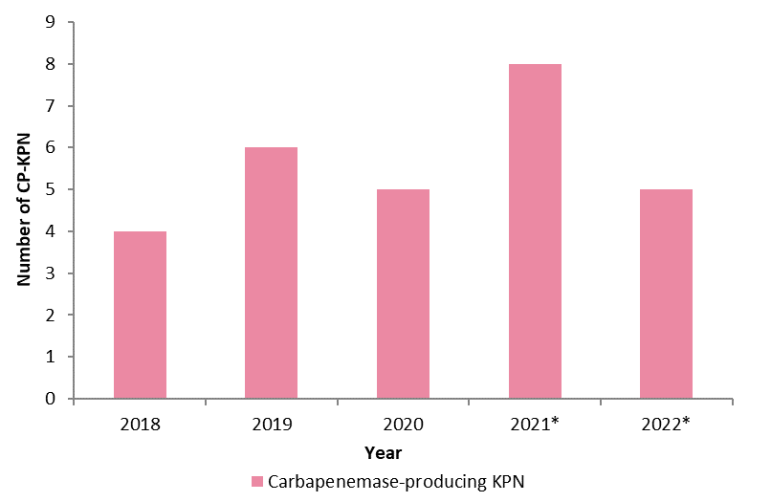
Carbapenem Resistance and Carbapenemase Producing Klebsiella pneumoniae
There is no trend for either carbapenem-resistant or carbapenemase-producing K. pneumoniae
*Data is missing from one laboratory for each of 2021 and 2022
EARS-Net Data on Antimicrobial Resistance in Ireland, 2022

Slide 38
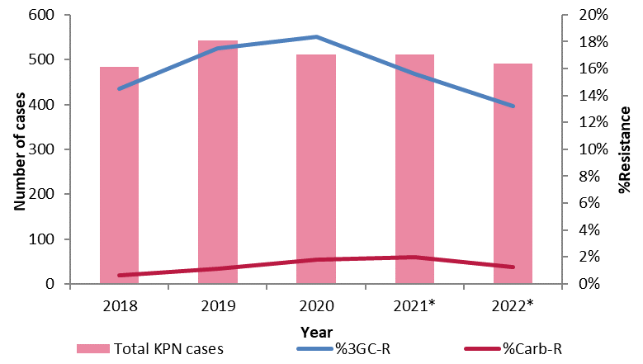
Trends in 3GC- and carbapenem-resistant
Klebsiella pneumoniae
3GC, 3rd-Generation Cephalosporins (include cefotaxime, ceftazidime)
Carb, Carbapenems
* Data is missing from one laboratory for each of2021 and 2022
Significant 5-year trend
EARS-Net Data on Antimicrobial Resistance in Ireland, 2022

Slide 39
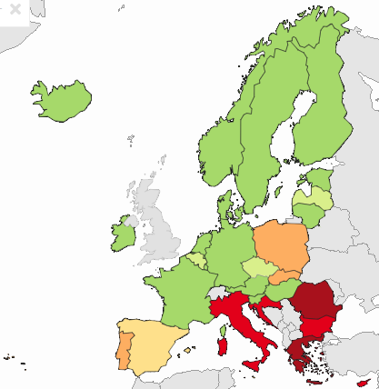
Carbapenem-resistant K. pneumoniae in EARS-Net countries in 2021
Data for 2022 not yet available
IRL rank: 23/29 (0.6%)
EU/EEA: 11.7%
(population-weighted mean)
Ireland has one of the lowest % of carbapenem-resistant K. pneumoniae in the EU/EEA
Carbapenem resistance in K. pneumoniae is increasing in the EU/EEA, primarily driven by countries in Southern Europe:
2 countries have proportions >50%
with a further 4 >25%
Significant 5-year trend
Source: Health Atlas, ECDC (data downloaded 26/09/2022)
EARS-Net Data on Antimicrobial Resistance in Ireland, 2022

Slide 40
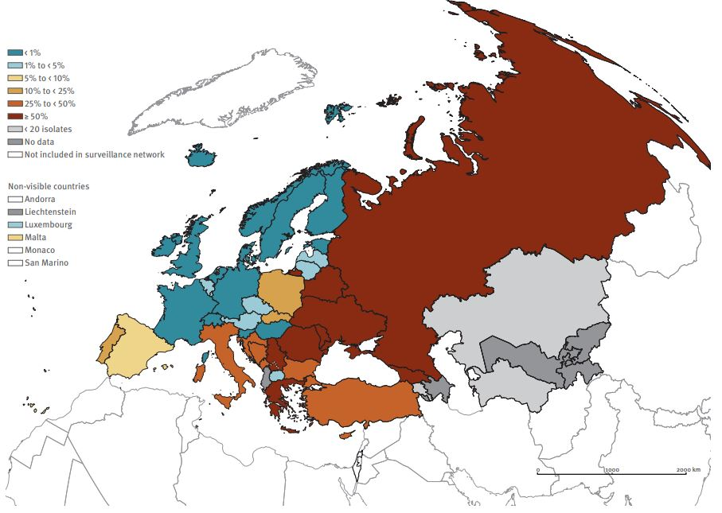
Carbapenem-resistant Klebsiella pneumoniae in Europe
combining data from EARS-Net and CAESAR*
Note: this map shows data for 2021, not 2022
*CAESAR, Central Asian and European Surveillance of Antimicrobial Resistance Network
Carbapenem-resistant K. pneumoniae is a major threat to public health throughout Europe with most countries in Eastern Europe reporting proportions >50%
Source: Antimicrobial Resistance Surveillance in Europe 2023 – 2021 Data, ECDC and WHO
EARS-Net Data on Antimicrobial Resistance in Ireland, 2022

Slide 41
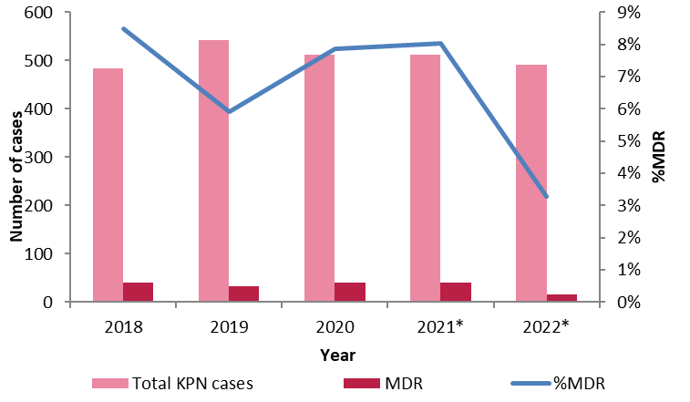
Trends in multi-drug resistant Klebsiella pneumoniae
MDR, Multi-Drug Resistance (defined as combined resistance to 3GCs, fluoroquinolones and aminoglycosides)
* Data is missing from one laboratory for 2021 and 2022
Significant 5-year trend
EARS-Net Data on Antimicrobial Resistance in Ireland, 2022

Slide 42
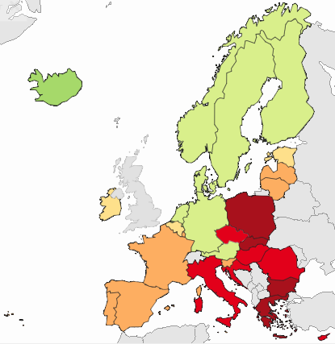
Multi-drug resistant (MDR) K. pneumoniae in EARS-Net countries in 2021
Data for 2022 not yet available
IRL rank: 20/29 (7.6%)
EU/EEA: 21.2%
(population-weighted mean)
Ireland still has one of the lowest proportions of MDR in K. pneumoniae in Europe
The highest levels of MDR in K. pneumoniae are seen in Eastern and Southern Europe
Significant 5-year trend
MDR: Multi-Drug Resistance
Source: Tessy 2022 Data, ECDC
EARS-Net Data on Antimicrobial Resistance in Ireland, 2022

Slide 43
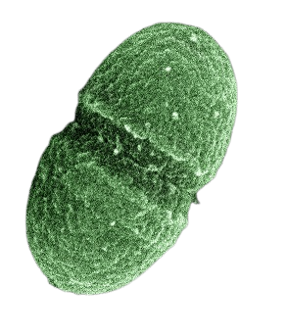
Invasive Enterococcus faecium
infections

Slide 44
Invasive Enterococcus faecium Infections
Key Points
The number of invasive E. faecium infections increased by 5% between 2021 and 2022 (data adjusted to include only those laboratories that consistently reported data over the latest 5-year period)
Vancomycin-resistance among E. faecium (VREfm) has remained stable at 25.7% in 2022 (2021, 25.5%). Overall, the 5-year trend indicates that the %VREfm is decreasing
VRE, especially among E. faecium (or VREfm), is a growing problem throughout the EU/EEA area; Ireland is one of a few countries where there has been a decreasing trend in %VREfm in recent years:
  Although the absolute numbers of VREfm have remained relatively stable over past five years (range, 167-178), the decrease in %VREfm is largely driven by the increase in vancomycin-susceptible E. faecium (VSEfm): from 250 in 2018 to 456 in 2022
EARS-Net Data on Antimicrobial Resistance in Ireland, 2022

Slide 45
Invasive Enterococcus faecium Infections
VRE, Vancomycin Resistant Enterococcus
HLG, High Level Gentamicin
MDR, Multi-Drug Resistance (defined as combined ampicillin, high-level gentamicin and vancomycin)
*Not all isolates tested
‡ Data is missing from one laboratory for each of 2021 and 2022
EARS-Net Data on Antimicrobial Resistance in Ireland, 2022

Slide 46
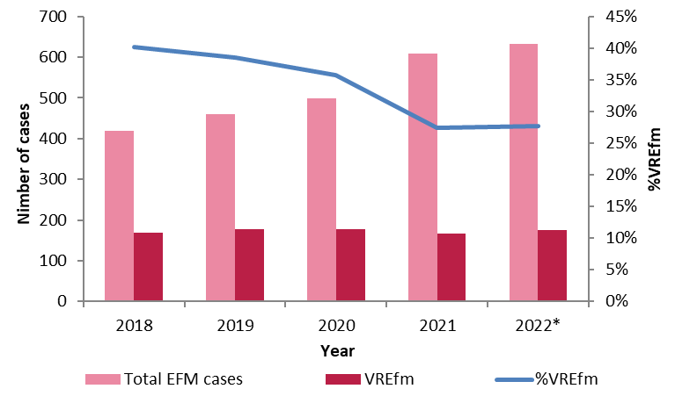
Trends in vancomycin-resistant Enterococcus faecium
The %VREfm has decreased significantly from 40.2% in 2018 to 27.7% in 2022
While the overall number of invasive E. faecium infections has been increasing steadily, the number of VREfm has remained relatively stable with the majority of additional cases due to vancomycin-susceptible E. faecium (VSEfm)
VRE, Vancomycin Resistant Enterococcus
HLG, High Level Gentamicin
MDR, Multi-Drug Resistance (defined as combined ampicillin, high-level gentamicin and vancomycin)
* Data is missing from one laboratory for each of 2021 and 2022
Significant 5-year trend
EARS-Net Data on Antimicrobial Resistance in Ireland, 2022

Slide 47
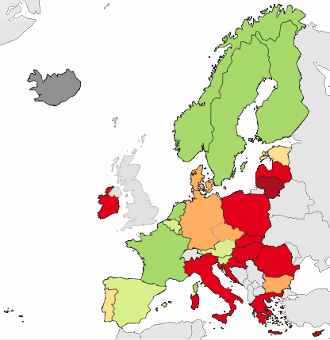
Vancomycin-resistant E. faecium (VREfm) in EARS-Net countries in 2021
Data for 2022 not yet available
IE rank: 12/28 (27.6%)
EU/EEA: 17.2%
(population-weighted mean)
Despite the decreasing trend in recent years, Ireland still has a high proportion of VREfm
VREfm is increasing across the EU/EEA, with the highest proportions in Eastern Europe and Ireland:
3 countries have proportions >50%, with a further 9 >25%
Significant 5-year trend
VRE: Vancomycin Resistant Enterococcus faecium
Source: Tessy 2022 Data, ECDC
EARS-Net Data on Antimicrobial Resistance in Ireland, 2022

Slide 48
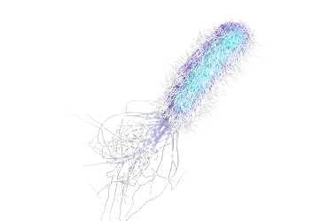
Invasive Pseudomonas aeruginosa infections

Slide 49
Invasive Pseudomonas aeruginosa Infections
Key Points
The number of invasive P. aeruginosa infections increased by 11% between 2021 and 2022 (data adjusted to include only those laboratories that consistently reported data over the latest 5-year period)
Resistance to the key antibiotics shows no discernible trend over the past 5 years
A change to the case definition for P. aeruginosa in 2020 has had an impact on the MDR data from 2020 onwards:
  5.2% of isolates were MDR in 2022 compared with 6.1% in 2021
EARS-Net Data on Antimicrobial Resistance in Ireland, 2022

Slide 50
Invasive Pseudomonas aeruginosa Infections
MDR, Multi-Drug Resistance (combined resistance to 3 or more of the 5 required antibiotic classes)
*Not all isolates tested
‡ Data is missing from one laboratory for each of 2021 and 2022
EARS-Net Data on Antimicrobial Resistance in Ireland, 2022

Slide 51
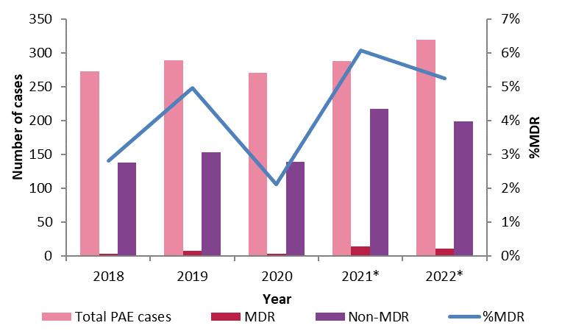
Trends in multi-drug resistant (MDR) Pseudomonas aeruginosa
A change to the case definition for P. aeruginosa in 2020 has had an impact on the MDR data reported since then
MDR, Multi-Drug Resistance (combined resistance to 3 or more of the 5 required antibiotic classes)
* Data is missing from one laboratory for each of 2021 and 2022
Significant 5-year trend
EARS-Net Data on Antimicrobial Resistance in Ireland, 2022

Slide 52
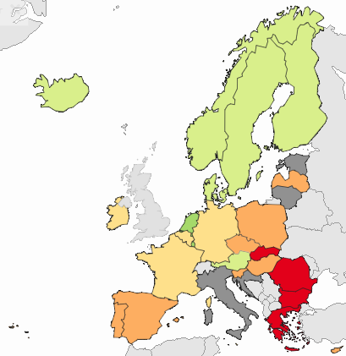
Multi-drug resistant Pseudomonas aeruginosa in Europe
Data for 2022 not yet available
IE rank: 17/25 (6.2%)
EU/EEA: 12.6%
(population-weighted mean)
The highest proportions of MDR P. aeruginosa are seen in Eastern and Southern Europe
Significant 5-year trend
Source: Health Atlas, ECDC (data downloaded 26/09/2022)
EARS-Net Data on Antimicrobial Resistance in Ireland, 2022

Slide 53

Invasive Streptococcus pneumoniae infections

Slide 54
Invasive Streptococcus pneumoniae Infections
Key Points
The number of invasive S. pneumoniae infections increased by 69% between 2021 and 2022; however, the number of infections remains lower than pre-pandemic levels (data adjusted to include only those laboratories that consistently reported data over the latest 5-year period)
In 2022, 23.4% (almost 1 in 4) of all invasive S. pneumoniae isolates were penicillin non-wild type (Pen-NWT)
Pen-NWT among invasive S. pneumoniae infections has increased over the past 4 years, but the increase was only 3 percent compared to pre-pandemic levels.
*Penicillin non-wild type (Pen-NWT) refers to S. pneumoniae isolates reported as either “susceptible, increased exposure”(I) or resistant (R); with MICs above those of the wild type isolates (>0.06mg/L)
EARS-Net Data on Antimicrobial Resistance in Ireland, 2022

Slide 55
Invasive Streptococcus pneumoniae Infections
WT: Wild Type
** Reconciliation with CIDR data not done for 2022 data due to resource issues at HPSC
*Not all isolates tested
‡ Data is missing from one laboratory for each of 2021 and 2022
*Wild type (WT) organisms are those with no phenotypically detectable resistance mechanisms (acquired or by mutation) to a particular antimicrobial:
Penicillin-WT strains of S. pneumoniae are typically susceptible to penicillin
EARS-Net Data on Antimicrobial Resistance in Ireland, 2022

Slide 56
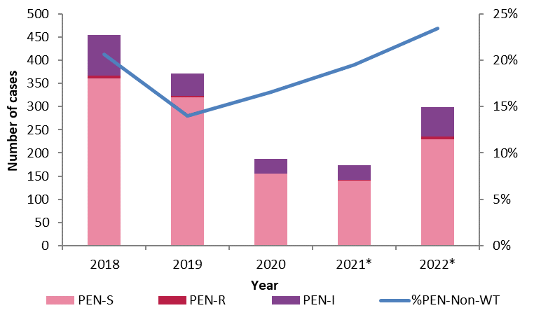
Penicillin-non-wildtype Streptococcus pneumoniae trends
PEN-Non-WT is comprised of both PEN-R and PEN-I
Invasive S. pneumoniae infection numbers decreased significantly during the COVID-19 pandemic. The number of cases started increasing again in 2022.
The %PEN-Non-WT has been increasing steadily since 2019 and it reached to 23.4 % in 2022.
WT, Wild Type
*Data is missing from one laboratory for each of 2021 and 2022
Significant 5-year trend
EARS-Net Data on Antimicrobial Resistance in Ireland, 2022

Slide 57
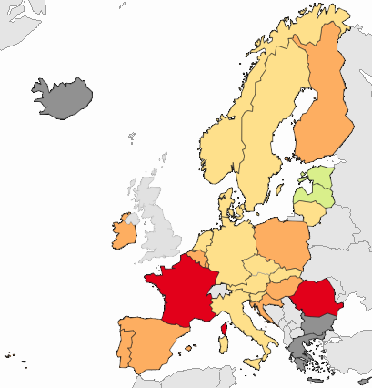
Penicillin non-wild type S. pneumoniae in EARS-Net countries in 2021
Data for 2022 not yet available
IE rank: 4/24* (19.6%)
EU/EEA: 16.3%
(population-weighted mean)
*Countries with >20 isolates
In 2021, the number of invasive S. pneumoniae infections reported across EU/EEA countries increased by 21% compared to 2020
(following a big decrease due to the COVID-19 pandemic)
5-year trend
Source: Health Atlas, ECDC (data downloaded 26/09/2022)
EARS-Net Data on Antimicrobial Resistance in Ireland, 2022

Slide 58
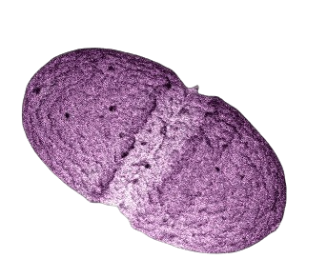
Invasive Enterococcus faecalis infections

Slide 59
Invasive Enterococcus faecalis Infections
Key Points
The number of invasive E. faecalis infections increased by 5% between 2021 and 2022 (data adjusted to include only those laboratories that consistently reported data over the latest 5-year period)
Five isolates (1.3%) were vancomycin-resistant in 2022 (2021, 0.3%). Overall, the 5-year trend indicates that this is increasing (but numbers are still very low)
High-level gentamicin resistance among E. faecalis has remained stable at 16.4% in 2022 (2021, 16.7%). Overall, the 5-year trend indicates that this is decreasing
No linezolid-resistant E. faecalis were reported in 2022. Over the previous four years, 2 linezolid-resistant isolates were reported, both from 2022 and both were optrA+ and cfr-
EARS-Net Data on Antimicrobial Resistance in Ireland, 2022

Slide 60
Invasive Enterococcus faecalis Infections
VRE: Vancomycin Resistant Enterococcus
HLG: High Level Gentamicin
*Not all isolates tested
‡ Data is missing from one laboratory for each of 2021 and 2022
High-level gentamicin resistance in E. faecalis has shown a decreasing trend over the past 5 years, from 23.6 % in 2018 to 16.4 % in 2022
EARS-Net Data on Antimicrobial Resistance in Ireland, 2022

Slide 61
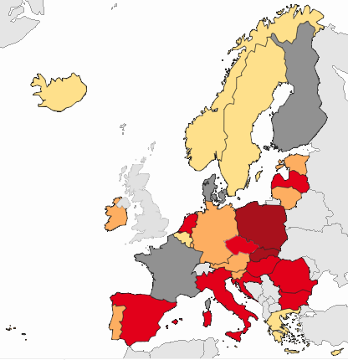
High-level gentamicin-resistant E. faecalis in EARS-Net countries in 2021
Data for 2022 not yet available
IE rank: 15/23 (17.3%)
EU/EEA: 29.0%
(population-weighted mean)
The highest proportions are seen in Eastern and Southern Europe
5-year trend
Source: Health Atlas, ECDC (data downloaded 26/09/2022)
EARS-Net Data on Antimicrobial Resistance in Ireland, 2022

Slide 62

Invasive Acinetobacter infections

Slide 63
Invasive Acinetobacter Infections
Key Points
The number of invasive Acinetobacter spp. infections increased by 11% between 2021 and 2022 (data adjusted to include only those laboratories that consistently reported data over the latest 5-year period)
Resistance to all key antibiotics, including carbapenems, remains at low levels (<3%)
No multi-drug resistance (MDR) among invasive Acinetobacter spp. infections was reported in Ireland in 2022
MDR Acinetobacter spp. is a major problem in Southern and Eastern European countries, with 15 countries reporting proportions in excess of 75% in 2021
EARS-Net Data on Antimicrobial Resistance in Ireland, 2022

Slide 64
Invasive Acinetobacter Infections
MDR: Multi-drug resistance defined as combined resistance to carbapenems (imipenem/meropenem), fluoroquinolones and aminoglycosides
*Not all isolates tested
‡ Data is missing from one laboratory for each of 2021 and 2022
EARS-Net Data on Antimicrobial Resistance in Ireland, 2022

Slide 65
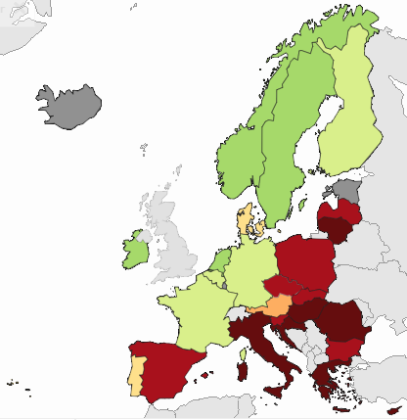
Multi-drug resistant (MDR) Acinetobacter spp. in EARS-Net countries in 2021
Data for 2022 not yet available
Only one MDR isolate has been reported in Ireland over the past 5 years (in 2019)
IE rank: joint 22/25 (0%)
EU/EEA: 36.8%
(population-weighted mean)
MDR in Acinetobacter spp. is a major problem in Eastern and Southern European countries:
75-100% = 7 countries
(Croatia = 98.5%)
50-<75% = 8 countries
5-year trend
Source: Health Atlas, ECDC (data downloaded 26/09/2022)
EARS-Net Data on Antimicrobial Resistance in Ireland, 2022

Slide 66
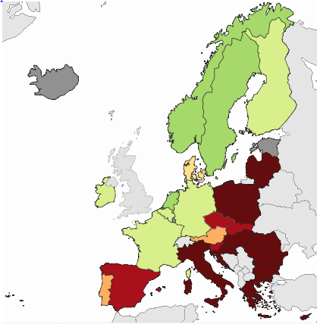
Carbapenem-resistant Acinetobacter spp. in EARS-Net countries in 2021
Data for 2022 not yet available
IE rank: 21/25 (1.5%)
EU/EEA: 39.9%
(population-weighted mean)
Carbapenem resistance in Acinetobacter spp. remains at low levels in Ireland and other Northern European countries
Carbapenem resistance in Acinetobacter spp. is a major problem in Eastern and Southern Europe, with 14 countries having proportions >50% (up from 11 in 2020): WHO has listed this as a critical priority
5-year trend
Source: Health Atlas, ECDC (data downloaded 26/09/2022)
EARS-Net Data on Antimicrobial Resistance in Ireland, 2022

Slide 67
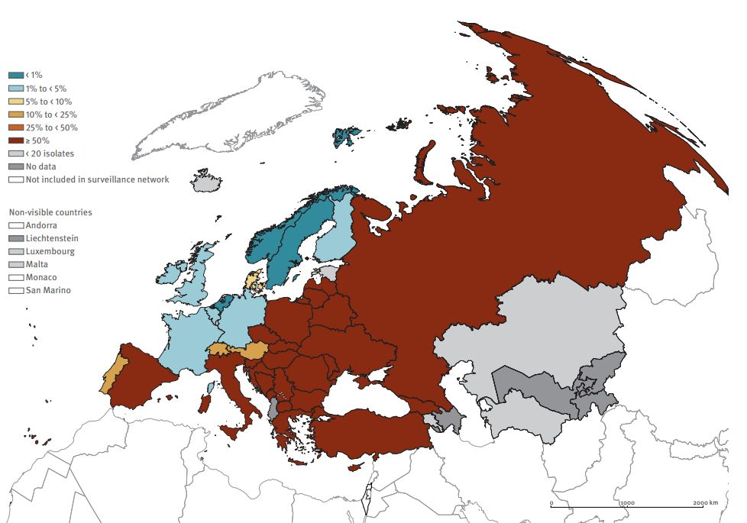
Carbapenem-resistant Acinetobacter spp. in Europe
combining data from EARS-Net and CAESAR*
Note: this map shows data for 2021, not 2022
*CAESAR, Central Asian and European Surveillance of Antimicrobial Resistance Network
Carbapenem-resistant acinetobacter is a major threat to public health throughout Europe with most countries in Eastern and Southern Europe reporting proportions >50%
Source: Antimicrobial Resistance Surveillance in Europe 2023 – 2021 Data, ECDC and WHO
EARS-Net Data on Antimicrobial Resistance in Ireland, 2022

Slide 68

Other
Non-EARS-Net
Pathogens

Slide 69
Invasive Group A streptococcal (iGAS) Infections
* Not all isolates tested
** Reconciliation with CIDR data was not done for 2022 data due to resource issues at HPSC
‡ Data is missing from one laboratory for each of 2021 and 2022
iGAS infections decreased significantly during COVID-19 pandemic but an unusual upsurge in cases was observed at the end of 2022.
For more details, see https://www.hpsc.ie/a-z/other/groupastreptococcaldiseasegas/
EARS-Net Data on Antimicrobial Resistance in Ireland, 2022

Slide 70
Invasive Group B streptococcal (iGBS) Infections
*Not all isolates tested
‡ Data is missing from one laboratory for each of 2021 and 2022
Only one MDR isolate has been reported in Ireland over the past 5 years (in 2019)
EARS-Net Data on Antimicrobial Resistance in Ireland, 2022

Slide 71
Invasive Candida Infections
The number of Candida infections has been stable in the last two years:
In 2022, 26 laboratories reported 285 cases of invasive Candida spp. infection from 281 patients: 4 patients had multiple Candida infections
No cases were reported from 10 laboratories
Since 2017, no C. auris from invasive infections have been reported
EARS-Net Data on Antimicrobial Resistance in Ireland, 2022

Slide 72
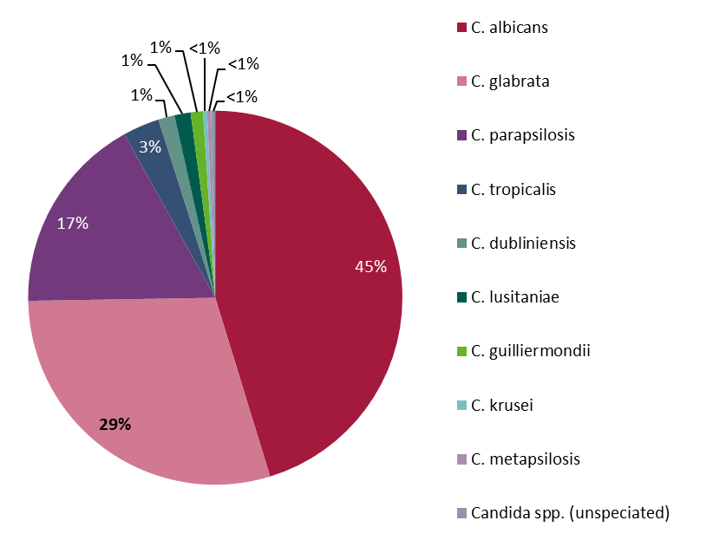
Invasive Candida Infections
It is strongly recommended that all Candida species from bloodstream infections are speciated in order to exclude C. auris
EARS-Net Data on Antimicrobial Resistance in Ireland, 2022

Slide 73
Acknowledgements
All microbiology laboratories for their continued support for EARS-Net and for providing data for this report
EARS-Net Steering Group
Microbiology Team at HPSC
Irish Meningitis and Sepsis Reference Laboratory (IMSRL)
National Carbapenemase-Producing Enterobacteriaceae Reference Laboratory Service (CPEaRLS)
EARS-Net at ECDC for providing the European data
EARS-Net Data on Antimicrobial Resistance in Ireland, 2022

