Slide 1
Health Protection Surveillance Centre
Surveillance of Zoonotic and Vectorborne disease in Ireland:
Q3 2019 provisional data
December, 2019

Slide 2
Provisional data, Q3 2019

Slide 3
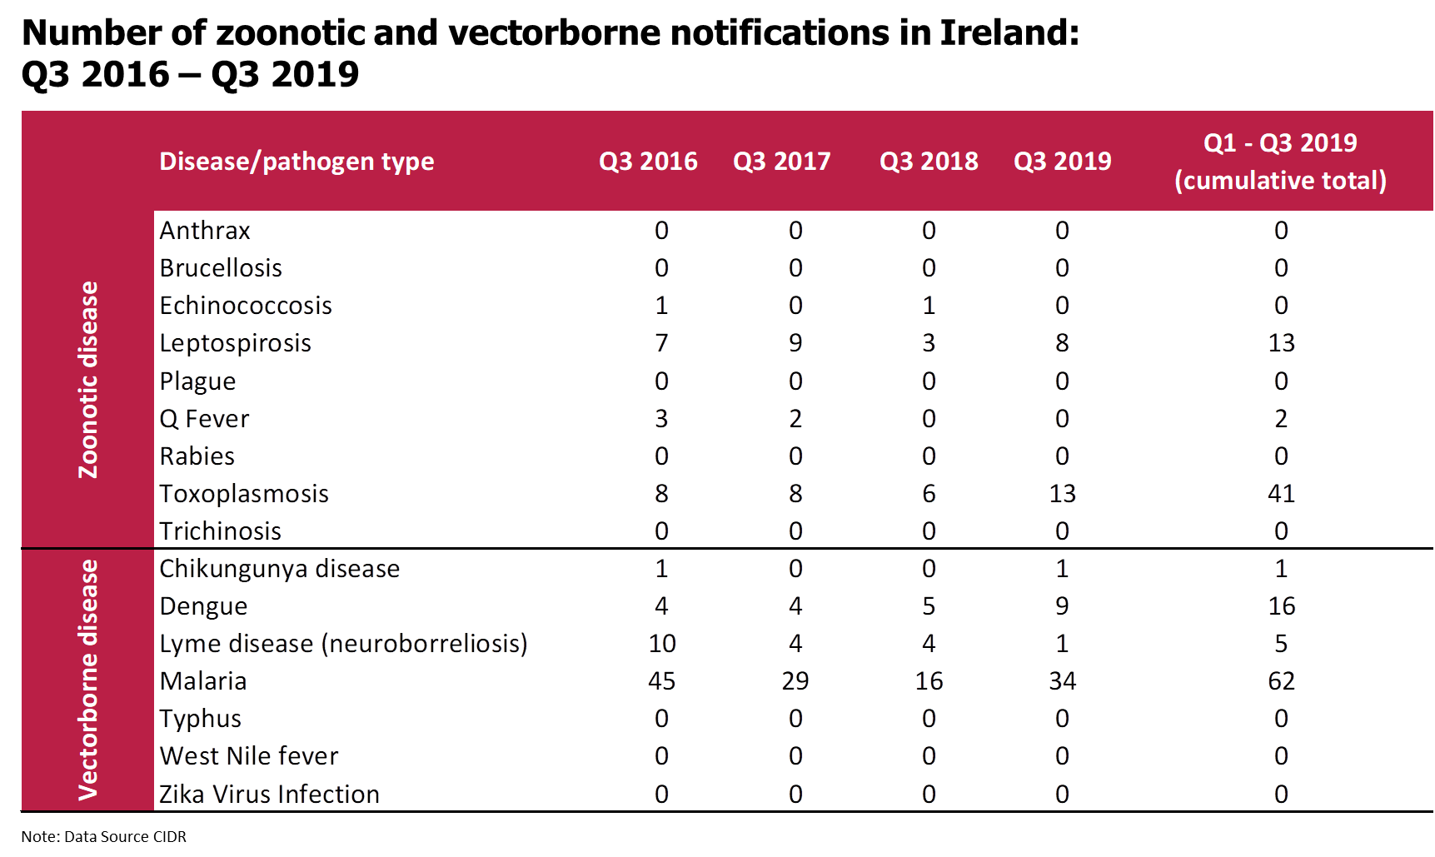

Slide 4
Malaria in Ireland, Q3 2019
Note: Data Source CIDR

Slide 5
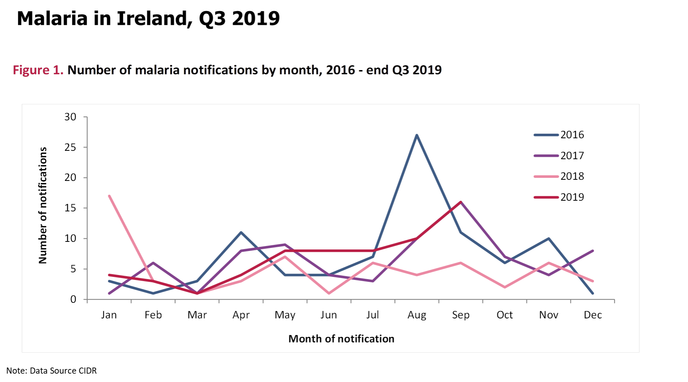

Slide 6
Further Information
Further information on Zoonotic and Vectorborne disease in Ireland can be found at
https://www.hpsc.ie/a-z/vectorborne/
https://www.hpsc.ie/a-z/zoonotic/

