Slide 1
Health Protection Surveillance Centre
Surveillance of Zoonotic and Vectorborne disease in Ireland:
Q1 2019 provisional data
July, 2019

Slide 2
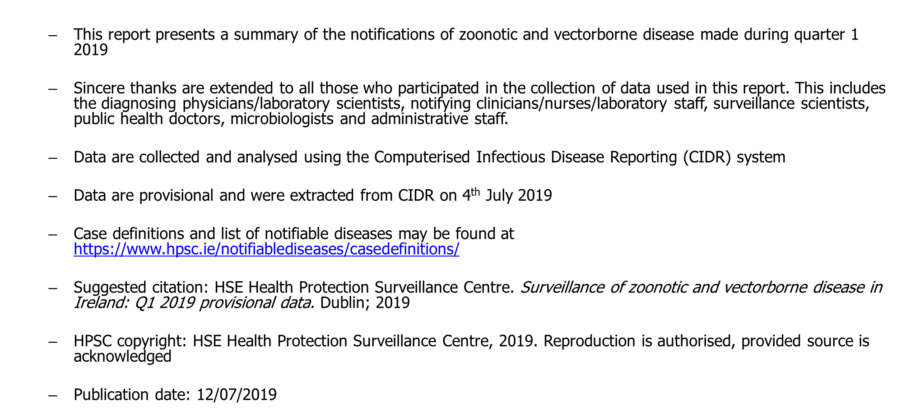
Provisional data, Q1 2019

Slide 3
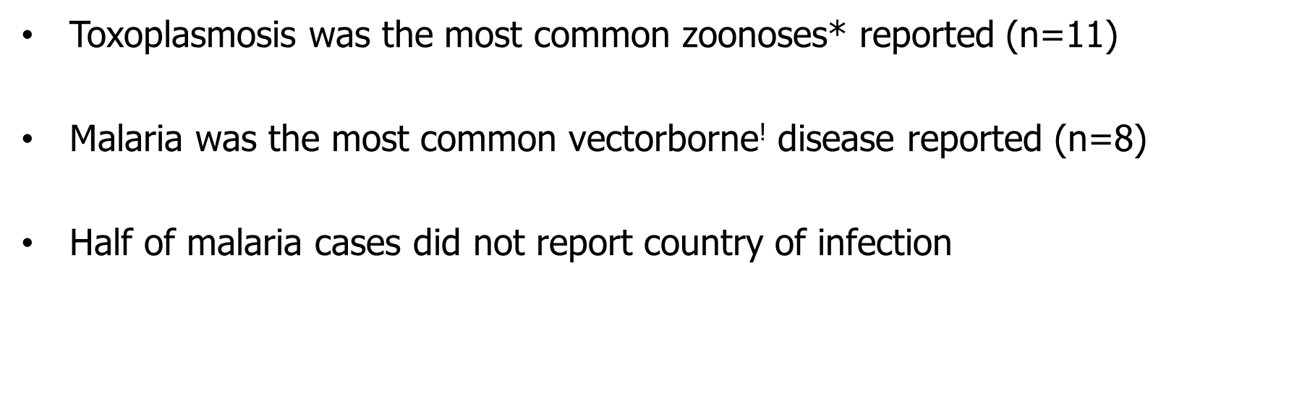
Key Points – Q1 2019 zoonotic and vectorborne disease

Slide 4
Number of zoonotic and vectorborne notifications in Ireland: Q1 2016 – Q1 2019

Slide 5
Malaria in Ireland, Q1 2019

Slide 6
Malaria in Ireland, Q1 2019

Slide 7
Further Information
Further information on Zoonotic and Vectorborne disease in Ireland can be found at
https://www.hpsc.ie/a-z/vectorborne/
https://www.hpsc.ie/a-z/zoonotic/

