Slide 1
COVID-19 Vaccination Uptake in Ireland
Weekly Report
Winter Campaign 2024
Week ending Sunday 1st December 2024
Latest Summary Statistics Absolute Numbers of COVID-19 Winter 2024 Campaign Doses and Percentage Uptake of the Census 2022 Population and other denominator estimates between 16/09/2024 and 01/12/2024 inclusive
Age Group | No. Booster Doses | Census 2022 Population/Other estimates | No. Booster doses as % Uptake Census 2022 Population/Other estimates
60-69yrs | 125122 | 510814 | 24.5
70-79yrs | 151944 | 357144 | 42.5
80+yrs | 101202 | 181027 | 55.9
HCWs | 19922 | 250000 | 8.0
LTCF residents | 24837 | 25000 | 99.3*
Slides prepared by the Health Protection Surveillance Centre 2nd December 2024
* See caveats on slide # 5

Slide 2
Winter 2024 COVID-19 Campaign Target Groups
The COVID-19 Winter 2024 vaccination campaign will officially start on 01/10/2024. However, because the National Cold Chain commenced deliveries of COVID-19 vaccines to GPs, Pharmacies and HSE from 16/09/2024, it has meant some GP clinics and pharmacies begun vaccine administration from this date. For the purposes of reporting henceforth, all figures from the week commencing 30/09/2024 will include those administered doses between 16/09/2024 and 30/09/2024 inclusive.
The administration of vaccine doses follows the guidelines set down by the National Immunisation Advisory Committee (NIAC), which are available here at https://rcpi.access.preservica.com/uncategorized/IO_e96fc7c5-1777-45d3-898e-5550336168aa/
The primary target groups of the Winter COVID-19 2024 vaccine campaign include those aged:
60 years and older;
6 months‐59 years:
with immunocompromised conditions associated with a suboptimal response to vaccination
with medical conditions associated with a higher risk of COVID‐19 hospitalisation, severe disease or death
18-59 years living in long term care facilities for older adults;
Health and care workers;
Pregnant women:
For pregnant women, a single primary vaccination dose is recommended. A booster dose is recommended all year and is not seasonal and can be given if it is more than six months since their previous dose or infection at any stage in pregnancy. The booster is ideally given between 20-34 weeks’ gestation. If it is more than 12 months since their previous COVID-19 vaccine or infection administration earlier in pregnancy should be considered.

Slide 3
Methodology
Data were provided by OCIO based on data in the data lake PROD environment (includes COVAX registered vaccinations and GP administered vaccinations).
DENOMINATOR USE: In this report, uptake is calculated based on Census 2022 population. See https://www.cso.ie/en/releasesandpublications/ep/p-cpsr/censusofpopulation2022-summaryresults/populationchanges/

Slide 4
Summary Findings I
Between 16/09/2024 and 01/12/2024
Total: 489,378 COVID-19 booster doses reported
Age Group: Booster dose uptake among
60-69 year olds was 24.5%
70-79 year-olds was 42.5%
80+ year olds, it was 55.9%
60+ years olds was 36.1%
Gender: Booster uptake was highest at 85+ years of age among males at 60.7% and among females at 54.3%
Among eligible persons aged 6 months to 59 years booster dose uptake for
6 months to 4 years was 0.0%
5-11 years was 0.0 %
12-59 years was 3.4%
Vaccination Location: Of the booster doses administered
61.2% were in GP clinics
9.5% in HSE clinics
29.3% in pharmacies
County of Residence: Uptake was highest at
33.9% among 60–69-year-olds in Co. Dublin
54.9% among 70-79 years olds in Co. Wicklow
70.7% among 80+ years olds in Co. Wicklow
47.1% among 60+ year olds in Co. Dublin

Slide 5
Summary Findings II
Between 16/09/2024 and 01/12/2024
Immunocompromised: NOTE: Reporting on the number vaccinated who are immunocompromised has been paused. This is in order to get further clarification from the National Immunisation Office on how best to identify individuals who are immunocompromised at the time of their latest COVID-19 dose and/or whether or not they also have a medical risk factor/condition that constitutes as being immunocompromised.
Pregnant women: 1,068 booster doses administered aged 18-59 years; uptake nationally was 4.7% among an estimated target pregnant population of 22,790
Healthcare workers (HCWs): 19,922 booster doses administered; uptake was highest in Co. Dublin at 43.4% and lowest in Co. Cork at 10.8% of the booster doses administered; uptake nationally was 7.7% among an estimated HCW population of 250,000
LTCF residents: 24,837booster doses have yet been administered; uptake was highest in Co. Dublin at 30.1% and lowest in Co. Cork at 12.2% of the booster doses administered; uptake nationally was 99.3% among an estimated LTCF resident population of 25,000. NOTE: This is likely to be an inflated estimate as are previously reported estimates for this cohort for the current Winter 2024 campaign because the denominator is too low.

Slide 6
COVID-19 Booster Doses by Age Group and Target Group between 16/09/2024 and 01/12/2024 inclusive
Period | Last Dose Course | Last Dose Classification/Type | 6 months-4 years of age eligible for vaccination | 5-11 years of age eligible for vaccination | 12-59 years of age eligible for vaccination | 60-69 years | 70-79 years | 80+ years | 60+ years | 6 months+ | LTCF residents 18-59 years* | LTCF residents 60+ years* | Pregnant women | HCWs | All
16/09/2024 to 01/12/2024 | Course2 | Booster | 12 | 30 | 14812 | 125122 | 151944 | 101202 | 378268 | 393122 | 1953 | 22881 | 1079 | 19922 | 489378
25/11/2024 to 01/12/2024 | Course2 | Booster | 1 | 1 | 603 | 4599 | 4024 | 2363 | 10986 | 11591 | 74 | 280 | 53 | 695 | 15983
* See CAVEATS on slide # 5

Slide 7
COVID-19 Booster Doses by Age Group between 16/09/2024 and 01/12/2024 inclusive
Age Group | No. Boosters | Census 2022 Population/Other denominator estimates | No. Booster doses % Uptake Population Census 2022/Other denominator estimates
All Ages | 489378 | 5149139 | 9.5
6months+ | 489378 | 5120241 | 9.6
6months-49yrs | 59053 | 3424088 | 1.7
5+yrs | 489366 | 4853724 | 10.1
12+yrs | 489288 | 4361794 | 11.2
12-17yrs | 767 | 431222 | 0.2
18+yrs | 488521 | 3930572 | 12.4
50+yrs | 430325 | 1696153 | 25.4
60+yrs | 378268 | 1048985 | 36.1
50-69yrs | 177179 | 1157982 | 15.3
65+yrs | 322505 | 776315 | 41.5
70+yrs | 253146 | 538171 | 47.0
12-69yrs | 236142 | 3823623 | 6.2
6months-4yrs | 12 | 266517 | 0.0
5-11yrs | 78 | 491930 | 0.0
12-59yrs | 111020 | 3312809 | 3.4
60-69yrs | 125122 | 510814 | 24.5
70-79yrs | 151944 | 357144 | 42.5
80+yrs | 101202 | 181027 | 55.9
HCWs | 19922 | 250000 | 8.0
Pregnant women | 1079 | 22790 | 4.7
LTCF residents | 24837 | 25000 | 99.3
* See CAVEATS on slide # 5

Slide 8
Percentage of Winter 2024 COVID-19 Booster Doses by Age Group and Other Specific Target Groups by Week administered between 16/09/2024 and 01/12/2024 inclusive * See CAVEATS on slide # 5
Age Group denominator based on census 2022;
Other approximate denominator estimates:
HCWs 250,000
Pregnant women 22,790
LTCF residents 25,000

Slide 9
Percentage of Winter 2024 COVID-19 Booster Doses by Specific Target Groups by Week administered between 16/09/2024 and 01/12/2024 inclusive
Age Group denominator based on census 2022;
Other approximate denominator estimates:
Immunocompromised 6months+ 63,000
HCWs 250,000
Pregnant women 22,790
LTCF residents 25,000

Slide 10
Uptake of Winter 2024 COVID-19 Booster Doses as a percentage of the Census 2022 population by age groups and gender administered between 16/09/2024 and 01/12/2024 inclusive

Slide 11
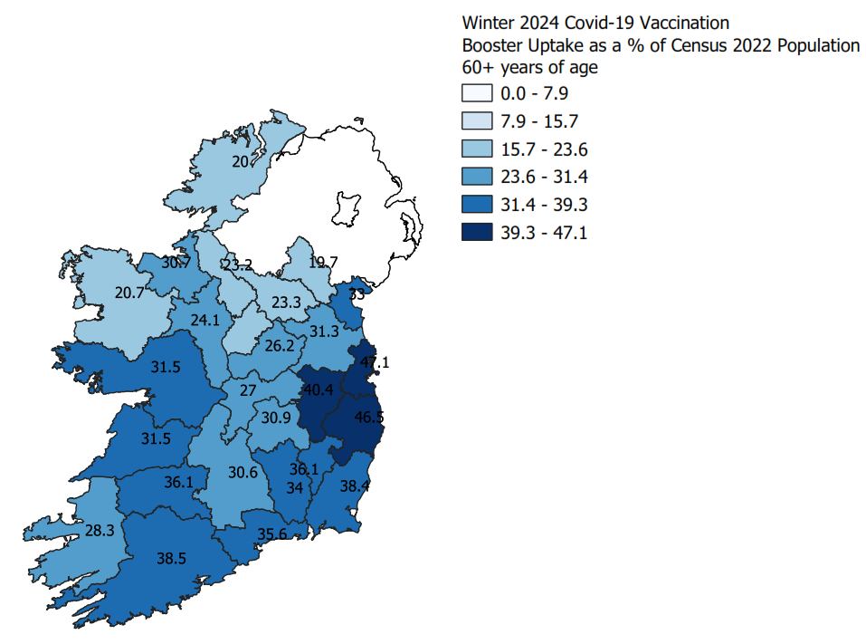
Uptake of Winter 2024 COVID-19 Booster Doses by county as a percentage of the Census 2022 population among 60+ year olds between 16/09/2024 and 01/12/2024 inclusive

Slide 12
Number of COVID-19 Winter 2024 booster doses administered to HCWs by age group and staff category administered between 16/09/2024 and 01/12/2024 inclusive
Occupation | <18 | 18-59 | 60-69 | 70-79 | 80+ | Total | % of Total
General Support Staff | 0 | 906 | 316 | 17 | 2 | 1241 | 6.2
Health & Social Care Professionals | 0 | 3996 | 448 | 32 | 1 | 4477 | 22.5
Management & Administration Staff | 1 | 2212 | 577 | 17 | 2 | 2809 | 14.1
Medical & Dental | 0 | 3572 | 293 | 17 | 2 | 3884 | 19.5
Nursing & Midwifery | 3 | 3663 | 489 | 13 | 0 | 4168 | 20.9
Patient Client Care Staff | 1 | 910 | 198 | 10 | 2 | 1121 | 5.6
General | 0 | 151 | 69 | 5 | 1 | 226 | 1.1
Retired | 0 | 0 | 7 | 1 | 0 | 8 | 0.0
Other | 0 | 327 | 58 | 6 | 0 | 391 | 2.0
Not specified | 32 | 1316 | 196 | 34 | 19 | 1597 | 8.0
Total | 37 | 17053 | 2651 | 152 | 29 | 19922 | 100.0

Slide 13
Number of COVID-19 Winter 2024 booster doses among HCWs by age and gender administered between 16/09/2024 and 01/12/2024 inclusive

Slide 14
Number of COVID-19 Winter 2024 booster doses among RCF residents by age and gender administered between 16/09/2024 and 01/12/2024 inclusive

Slide 15
Percentage of Winter 2024 COVID-19 Booster Doses by Distribution Channel administered between 16/09/2024 and 01/12/2024 inclusive

Slide 16
Caveats I
Uptake data reported refers to the period up to midnight of the last day of the latest epidemiological week Monday to Sunday.
Where county and/or age group calculation of estimated uptake exceeds 100% due to data capture issues within Coax or where the numerator exceeds the population estimate/denominator then the uptake will be rounded down to 99.9% (unless otherwise indicated in the report).
Total reported doses in this report now includes all vaccination doses on the IIS/COVAX data system, including those received abroad by Irish residents.
Reported figures excludes vaccination records where the death of the individual has been recorded.
While data is presented in terms of total number of people receiving boosters as a proportion of total population, it should be noted that not all people within these populations will be eligible for vaccination at a given time for example if they have recently had COVID-19 infection.
It was not possible to accurately summarise the number of individuals aged between 6 months and 4 years, between 5 and 11 years and between 12 and 59 years with underlying medical conditions because those details in the IIS/COVAX extract are combined in a complex way with target groupings.

Slide 17
Caveats II
The data in this report are based on the vaccination records stored on the COVAX system. The vaccination status and other variables on the person's account and vaccination record such as risk factors and cohorted groupings are as recorded on this system. For values recorded on the person's account, these may not be updated at each vaccination event depending on them being provided by the vaccine recipient and recorded at the time of vaccination.
Furthermore, for vaccinations given at GP practices and pharmacies, these other variables are not necessarily mandatory at the source of record (GP Practice or Pharmacy System) and so may not update changes on the person account in COVAX. As a result, in some cases, the data may reflect a historic value (such as risk factor or cohort).
In addition, a person may have more than one risk factor for a given vaccination event, but all relevant risk factors may not be recorded. For example, as HCW status is considered a risk factor, those who also have a medical condition (another risk factor) are likely to be recorded on IIS/COVAX with the latter rather as a HCW, thereby resulting in an under-reporting of vaccinated HCWs
Also, cohorting (such as healthcare worker) is dependent on this information being supplied by the vaccine recipient at the time of vaccination and this being recorded on the system of record. Therefore, this data presented in this report is based on the vaccination status of individuals registered on the COVAX system based on their last dose received.
This means that the risk factor profile of those same individuals may not reflect their actual status at that same time for the reasons explained above.
The data presented in this slide set focusses exclusively on all booster doses administered during the Winter 2024 campaign as the number of individuals who have competed their primary course treatment is quite small, so much so that the numbers will have a negligible impact on the calculation of the overall percentage uptake of COVID-19 vaccination in the general population.

Slide 18
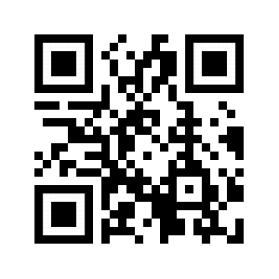
Acknowledgements
Sincere thanks to the following for providing the data for this report:
National Immunisation Office (NIO)
Office of the Chief Information Officer (OCIO)
HSE Integrated Information Services (IIS) and COVAX Implementation team of Salesforce, IBM, PWC, EY
HSE procurement/acute hospitals/CHOs/vaccinating teams and administrators/IT staff
HSE Health Intelligence, Strategic Planning & Transformation Unit
NHSS for Fair Deal Resident Data
HR-Sap for HSE HCW Data
@hpscireland
@hpscireland
www.hpsc.ie

Slide 19
Uptake of Winter 2024 Booster & Seasonal Influenza 2024 doses by HSE HCWs between 16/09/2024 to 23/11/2024
In total 108,127 records for HSE healthcare workers were included in the analysis.
Overall uptake by end of 23/11/2024
10,476 received COVID-19 vaccine, an uptake of 9.7%
27,660 received influenza vaccine, an uptake of 25.6%
Amongst those who received a vaccine:
9,958 (9.2%) received both COVID-19 and influenza vaccine
518 (0.5%) received COVID-19 vaccine only
17,702 (16.4%) received influenza vaccine only
79,949 (73.9%) did not receive any COVID-19 or influenza vaccine
97,651 (90.3%) did not get a COVID-19 vaccine
80,467 (74.4%) did not get an influenza vaccine

Slide 20
Uptake of Winter 2024 COVID-19 Booster & Seasonal Influenza doses by Fair Deal residents in residential care facilities between 16/09/2024 to 23/11/2024
526 residential care facilities were identified from a matched dataset.
Influenza Vaccination Uptake
Between 16/09/2024 and 23/11/2024, overall uptake among Fair Deal residents was 81.9% (n=19,517/23,821)
4 locations (0.8%) where no vaccinations were reported, or uptake was <=10%
4 locations (0.8%) had an uptake >=10% and <50%
87 locations (16.5%) had an uptake >=50% and <75%
311 locations (59.1%) had an uptake >=75% and <90%
108 locations (20.5%) had an uptake >=90% and <100%
11 locations (2.1%) had an uptake of 100%.
COVID-19 Vaccination Uptake
Between 01/10/2024 and 23/11/2024, overall uptake among Fair Deal residents was 74.4% (n=17,712/23,821)
4 locations (0.8%) where no vaccinations were reported, or uptake was <=10%
26 locations (4.9%) had an uptake >=10% and <50%
193 locations (36.7%) had an uptake >=50% and <75%
258 locations (49.0%) had an uptake >=75% and <90%
44 locations (8.4%) had an uptake >=90% and <100%
No locations (0.0%) had an uptake of 100%.

